Slide 1


AI-based Real-time Energy optimization Model at Ironmaking
A Vision to Execute Better.
Everyday.
Peddinti Bhuvaneswara Rao
Keshav Baheti
Mentor: Mr. Naveen Singh
Buddy: Mr. Mohanraj Nagarajan

Slide 2
Project Overview
Ironmaking process adopts relatively complete process technology and equipment, which provides a good research and development foundation and supporting environment for the application of blast furnace big data technology and the improvement of the level of ironmaking intelligence.
During the long-term operation of the blast furnace, a large amount of smelting process data will be accumulated, giving full play to the value of big data, and deep mining of the inherent laws contained in big data through artificial intelligence technology.
The blast furnace process is a "black box" operation, and the smelting process is unpredictable.
Effectively forecasting and guiding production, and finally achieving refined and intelligent ironmaking, is of great significance to the steel industry.

Slide 3




Project Goals
Cleaning and processing of Blast Furnace data to identify the interrelationships between input and output parameters.
Energy balance in blast furnace by finding input and output energies
Optimization techniques to minimize input energy
Developing of constraints on the input parameters using the interrelation of input and output parameters from historical data

Slide 4
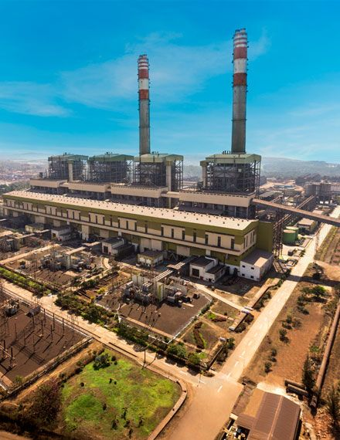
Agenda
Overview of The Blast Furnace
Calculation of Input Energy
Calculation of Output energy
Input and output energy composition at different conditions
Optimization techniques to get optimal input parameters

Slide 5
Agenda
Overview of The Blast Furnace
Calculation of Input Energy
Calculation of Output energy
Input and output energy composition at different conditions
Optimization techniques to get optimal input parameters

Slide 6
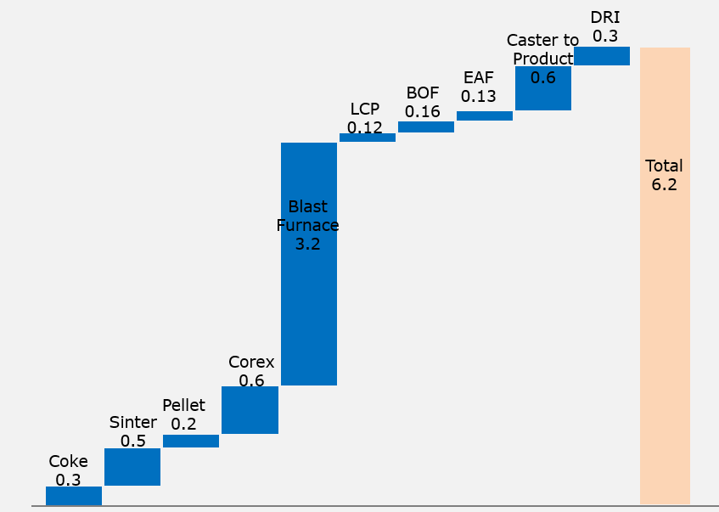
ISP Energy Intensity | Global Steel Industry
1
Energy Consumption in steel industry, Gcal/tcs
2
Energy Consumption in JSW VJNR, Gcal/tcs
Energy Consumption in EU, USA countries are low – Due to more scrap & low grid emission factor
Corex, Blast Furnace & Mill Zone are high energy consumption units

Slide 7
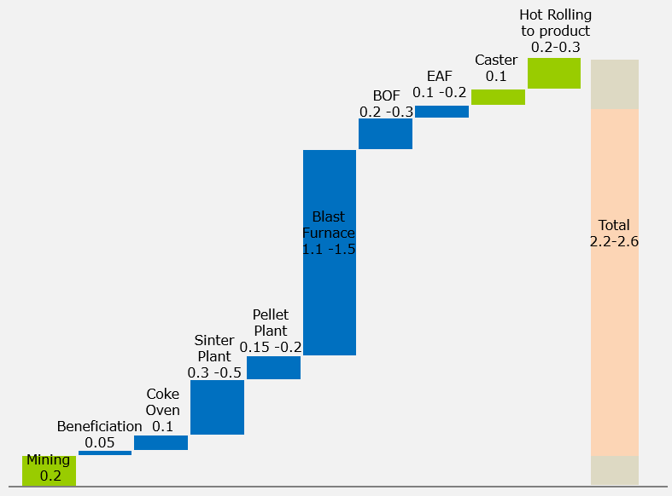
Steel Route & CO2 Emission | Global Steel Industry
1
Global Steel Production Route, %
2
70% Steel Production Route CO2 Emission break up, TCO2/TCS
Oxygen Route
Electric Route
~50 % of CO2 emission is from Blast Furnace
~15% of CO2 emission are from Sinter Plant
Presently 70% of production through oxygen route & 30 % from electric route
If China is not considered, then ratio will be 52 % :48 %

Slide 8
CO2 | Emissions
CO2 Emissions – Plant level
CO2 Emission Contributions – Shop Level
2.63 tons/tcs CO2 emissions in FY24
Steel Zone contributed to ~18% of total emissions
kg CO2/TCS
CO2 emissions (kg CO2/tcs) FY24 Actual
#Others: CPP, Boilers, Building lighting, etc.

Slide 9
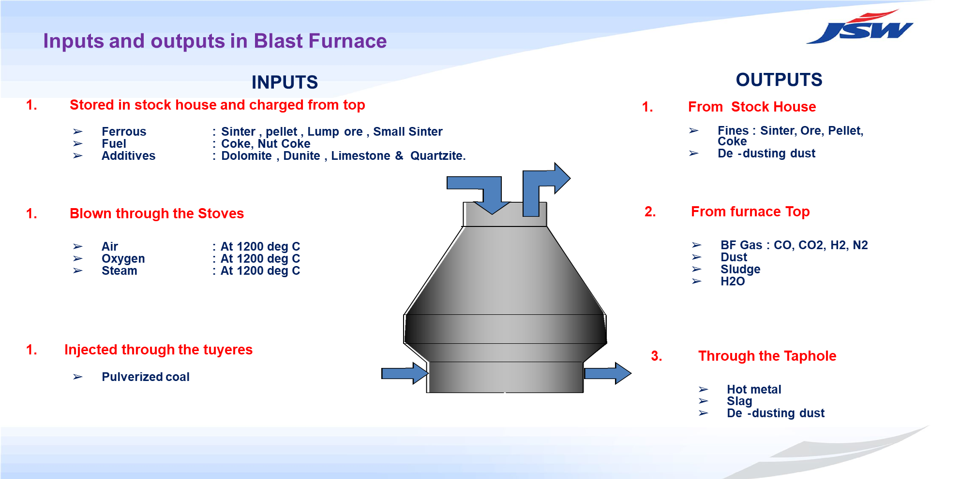
Overview of Blast Furnace
A blast furnace is a type of furnace used in metallurgy to produce iron from iron ore using a combination of coke as fuel and limestone as a flux.
It operates by continuously
feeding iron ore, coke, and fluxes
into the top, where a blast of hot air
or oxygen is blown through tuyeres (nozzles) at the base. This process produces molten iron and slag (a byproduct), which are tapped from
the bottom of the furnace.
The outputs of a blast furnace are molten iron (called pig iron) and slag.
INPUTS
OUTPUTS
Long Term

Slide 10
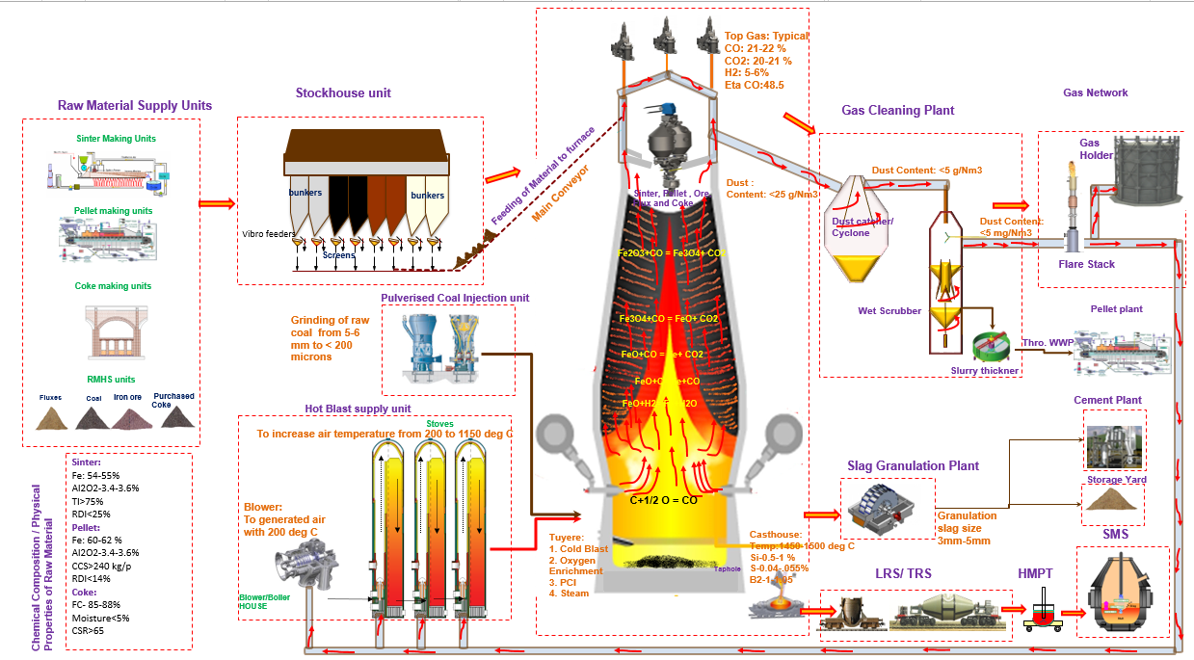
Overview of Blast Furnace

Slide 11
Time lag and Steady state operation of blast furnace
There is a time lag of about 4-5 hours, from the time when the raw material is added and the time when the output material is tapped due to the pressure applied by hot blast gas. This leads to decrease in speed of descent of material dropped from top of the Blast Furnace
The Principal components are Burden descent rate, Top gas Temperature, Gas Utilization, Differential Pressures and gas Permeability resistance for predicting the Hot Metal Temperature. Channeling is a non-homogenous condition of the Burden distribution where ascending gases tries to preferentially flow, resulting in changes in the Gas flow pattern in top gas and subsequently affects the Burden movement down the stock line.
During residence of hot metal inside the blast furnace, the hot metal comes in contact with dead man zone and hearth refractory, wherein the gradual thermal loss takes place. So, the longer it remains in the blast furnace the cooler it’s temperature gets.

Slide 12
Current method to find the amount of Coke and Coal
The present method for the amount of coke and coal used in one batch of Blast furnace operation depends upon the Hot Metal Temperature.
There is a fixed minimum value of Coke to be added per ton hot metal, then they add or remove the amount of coke based upon the hot metal temperature.
The problem with this method is:
There is delay in the time at which load is added and the time at which hot metal is tapped about a delay of 4-5 hours.
There is no Hot Metal prediction model for Blast Furnace-4 also the reading of the hot metal temperature is not taken hourly
The Temperature of Hot Metal varies from Tap hole to Tap hole due to the formation of Deadman inside the Blast furnace.
The Hot Metal Temperature depends on many other factors: Burden descent rate, Top gas Temperature, Gas Utilization(ETACO), Differential Pressures and Gas Permeability Resistance.
It also depends on Channeling, Channeling is condition of the Burden distribution where ascending gases tries to preferentially flow, resulting in changes in the Gas flow pattern in top gas and subsequently affects the Burden movement.

Slide 13
Blast Furnace – 4 | JSW Vijayanagar
Operating Parameters
Design Data
Parameter | Value
Production | 9830 t/day
Productivity (w/v) | 2.5 t/m³/day
Fuel Rate | 2.5 t/m³/day
Coke Rate | 520 Kg/THM
PCI Rate | 380 Kg/THM
Slag Rate | 160 Kg/THM
Sinter / Pellet / Lump Ore (%) | 80/10/10
Hot Blast Pressure | 4 bar
High Top Pressure | 2.5 bar
Hot Blast Temp | 1250°C
Cold Blast Volume | 5800 Nm³/min
O2 enrichment | 5-7%
Gas make | 525000 Nm³/hr
Area | Value | Unit
Diameter Throat | 9.6 | m
Belly | 15.16 | m
Hearth | 13.2 | m
Heights Throat | 1.57 | m
Stack | 17.6 | m
Belly | 3 | m
Bosh | 3.5 | m
Tuyere to Bosh | 0.6 | m
Taphole to Tuyere | 4.2 | m
Bottom to Taphole | 3.1 | m
Tap hole level | 11.06 | m
Tuyeres level | 15 | m
Furnace Top | 47.14 | m
Working | 26.3 | m
Total | 33.6 | m
Volumes Working | 3445 | m³
Inner | 4020 | m³
Production/hearth area | 57 | t/day/m2 hearth
Stack | 81.02 | Degrees
Bosh | 74.36 | Degrees

Slide 14
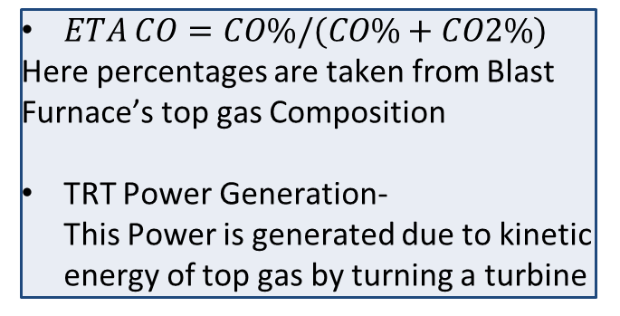
Full forms and Definitions
Abbreviation | Definition
N₂ | Nitrogen
O₂ | Oxygen
CO | Carbon Monoxide
CO₂ | Carbon Dioxide
CDI | Coal Dust Injection
PCI | Pulverized Coal Injection
Kcal | Kilo Calorie
H₂ | Hydrogen
Fe | Iron
Mn | Manganese
BF Gas | Blast furnace Gas
TRT | Top gas Recovery Turbine
KPI | Key Performance Index
Thm | Tonne Hot Metal
Nm³ | Normal Meter Cube
ETA CO | Carbon Utilization Efficiency
$ETA CO=CO\%/(CO\%+CO2\%)$
Here percentages are taken from Blast Furnace’s top gas Composition
TRT Power Generation- This Power is generated due to kinetic energy of top gas by turning a turbine
All the energies are calculated for per tonne of hot metal (thm).

Slide 15
Agenda
Overview of The Blast Furnace
Calculation of Input Energy
Calculation of Output energy
Input and output energy composition at different conditions
Optimization techniques to get optimal input parameters

Slide 16
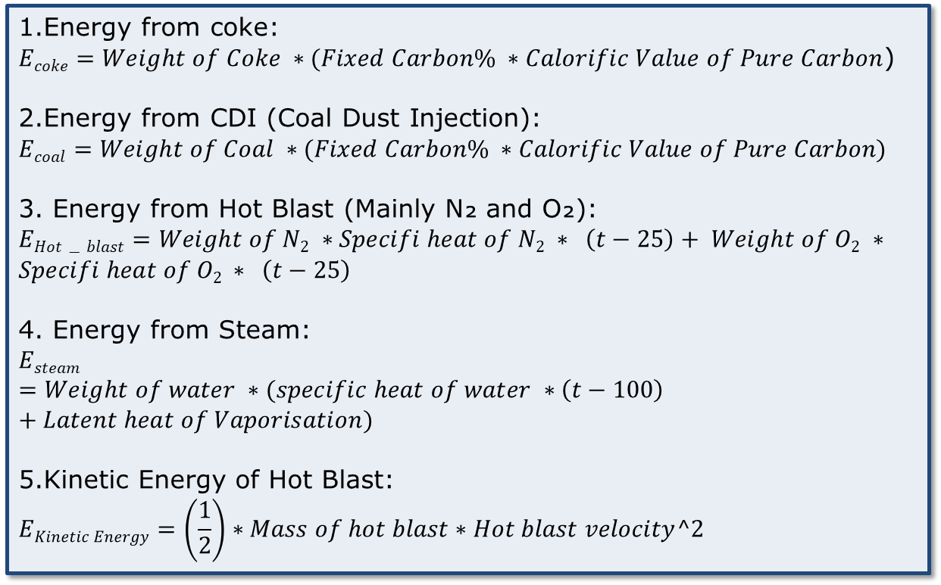
Input energy calculations
1.Energy from coke:
$Ecoke=Weight of Coke ∗(Fixed Carbon\% ∗Calorific Value of Pure Carbon$)
2.Energy from CDI (Coal Dust Injection):
$$Ecoal=Weight of Coal ∗(Fixed Carbon\% ∗Calorific Value of Pure Carbon)$$
3. Energy from Hot Blast (Mainly N₂ and O₂):
$$EHot−blast=Weight of N2 ∗Specifi heat of N2 ∗ \left(t−25\right)+ Weight of O2 ∗$$
$$Specifi heat of O2 ∗ \left(t−25\right)$$
4. Energy from Steam:
$$Esteam=Weight of water ∗(specific heat of water ∗\left(t−100\right)+Latent heat of Vaporisation)$$
5.Kinetic Energy of Hot Blast:
$$EKinetic Energy=\left(\frac{1}{2}\right)∗Mass of hot blast∗Hot blast velocity^2$$
Calorific Value of Pure carbon = 7800 Kcal/kg
Late heat of Vaporization = 540 Cal/kg
Specific heat of water = 1 Kcal/kg
Specific Heat of O₂ = 0.22 Kcal/kg.
Specific Heat of N₂ = 0.25 Kcal/kg.
Fixed Carbon is the amount of pure carbon in Coke/Coal
The Base Temperature is taken at 25 Degree Celsius and all energies are calculated per Ton of Hot Metal
$$Total Input Energy=Ecoke+Ecoal+EHot−blast+Esteam+Ekinetic Energy$$

Slide 17
Agenda
Overview of The Blast Furnace
Calculation of Input Energy
Calculation of Output energy
Input and output energy composition at different conditions
Optimization techniques to get optimal input parameters

Slide 18
Blast Furnace Gas Calculation
Volume from the Flow Sensor
Volume from the Gas Sensor data using the N₂ Conservation in both Input and Output

Slide 19
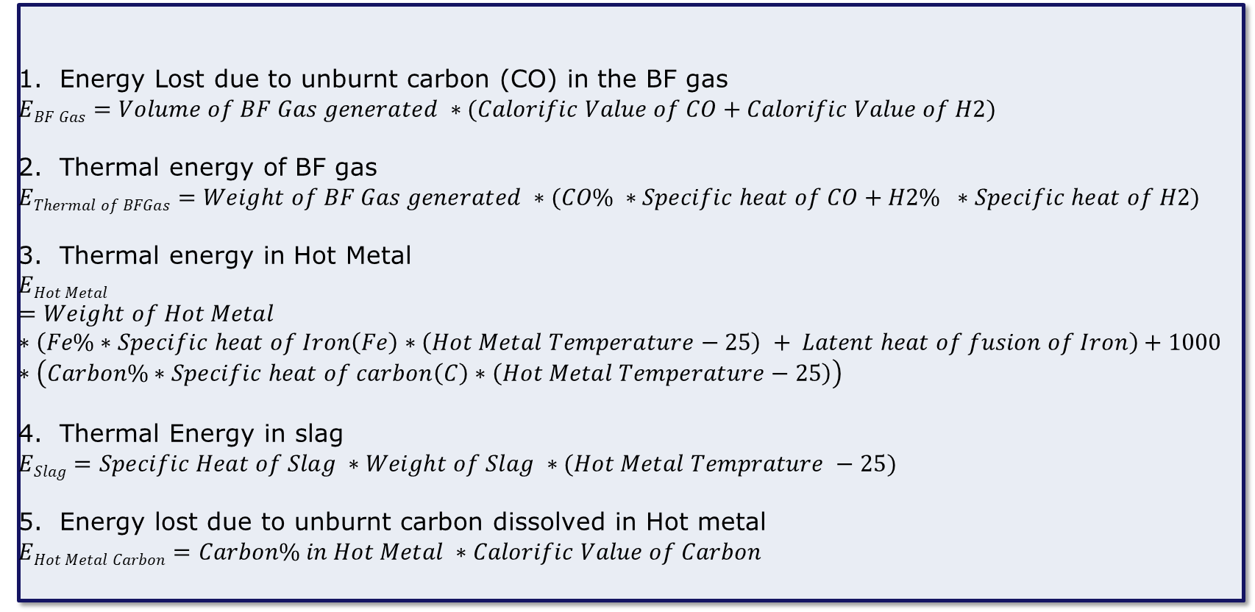
Output energy calculations
Energy Lost due to unburnt carbon (CO) in the BF gas
$$EBF Gas=Volume of BF Gas generated ∗(Calorific Value of CO+Calorific Value of H2)$$
Thermal energy of BF gas
$$EThermal of BFGas=Weight of BF Gas generated ∗(CO\% ∗Specific heat of CO+H2\% ∗Specific heat of H2)$$
Thermal energy in Hot Metal
$$EHot Metal=Weight of Hot Metal∗\left(Fe\%∗Specific heat of Iron\left(Fe\right)∗\left(Hot Metal Temperature−25\right) + Latent heat of fusion of Iron\right)+1000∗\left(Carbon\%∗Specific heat of carbon\left(C\right)∗\left(Hot Metal Temperature−25\right)\right)$$
Thermal Energy in slag
$$ESlag=Specific Heat of Slag ∗Weight of Slag ∗(Hot Metal Temprature −25)$$
Energy lost due to unburnt carbon dissolved in Hot metal
$$EHot Metal Carbon=Carbon\% in Hot Metal ∗Calorific Value of Carbon$$

Slide 20
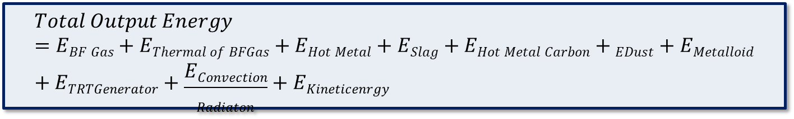
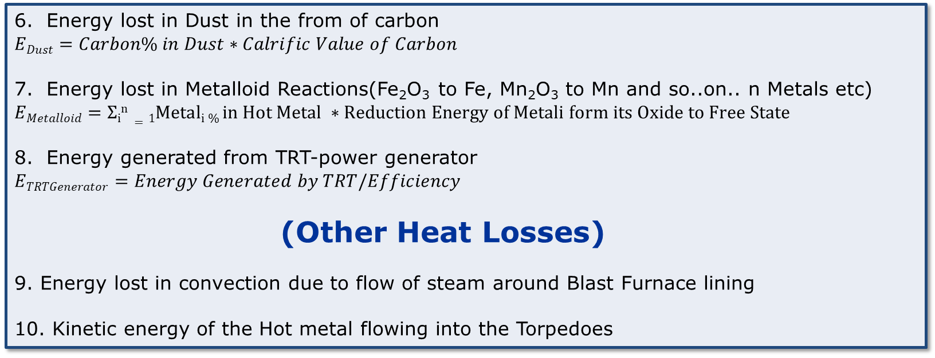
Output Energy Calculations
Energy lost in Dust in the from of carbon
$$EDust=Carbon\% in Dust∗Calrific Value of Carbon$$
Energy lost in Metalloid Reactions(Fe₂O₃ to Fe, Mn₂O₃ to Mn and so..on.. n Metals etc)
$$EMetalloid=Σin=1Metali \% in Hot Metal ∗Reduction Energy of Metali form its Oxide to Free State$$
Energy generated from TRT-power generator
$$ETRTGenerator=Energy Generated by TRT/Efficiency$$
(Other Heat Losses)
9. Energy lost in convection due to flow of steam around Blast Furnace lining
10. Kinetic energy of the Hot metal flowing into the Torpedoes
$$Total Output Energy=EBF Gas+EThermal of BFGas+EHot Metal+ESlag+EHot Metal Carbon+EDust+EMetalloid+ETRTGenerator+\frac{EConvection}{Radiaton}+EKineticenrgy$$

Slide 21
Agenda
Overview of The Blast Furnace
Calculation of Input Energy
Calculation of Output energy
Input and output energy composition at different conditions
Optimization techniques to get optimal input parameters

Slide 22
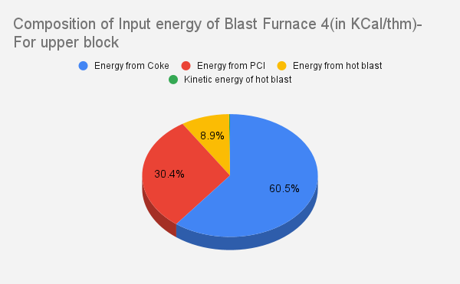
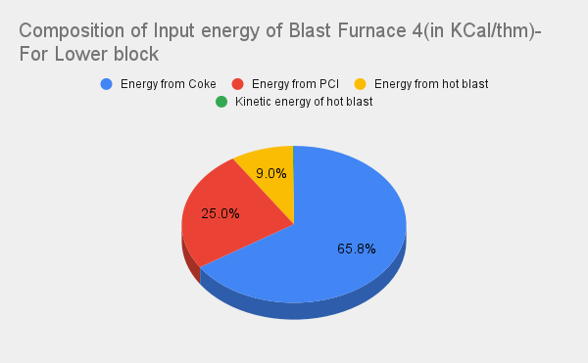
Input energy composition
From the Historical data of blast furnace input and output energies were calculated and their composition at different instances were recorded
At Lower Input Energy Average energy: 3609876.806 Kcal/thm
At Higher Input Energy Average energy: 3858442.951 Kcal/thm

Slide 23
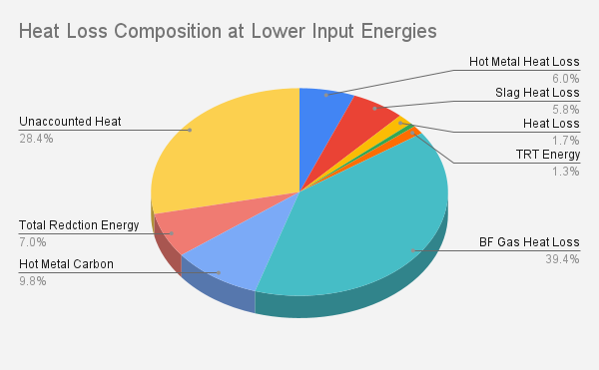

Output energy composition
At Lower Input Energy Average energy: 3609876.806 Kcal/thm
At Higher Input Energy Average Energy: 3858442.951 Kcal/thm

Slide 24
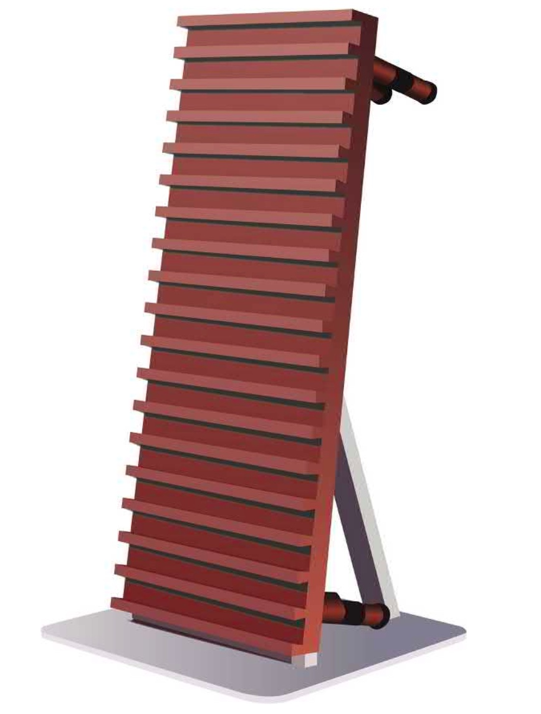
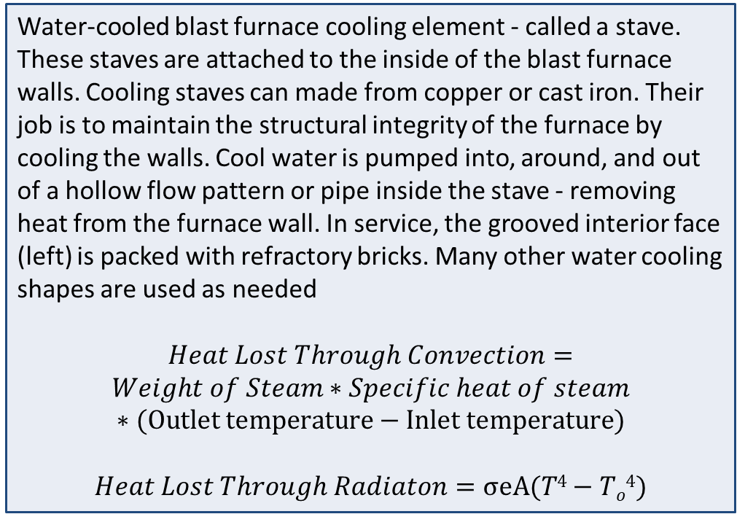
Unaccounted Heat losses
Water-cooled blast furnace cooling element - called a stave. These staves are attached to the inside of the blast furnace walls. Cooling staves can made from copper or cast iron. Their job is to maintain the structural integrity of the furnace by cooling the walls. Cool water is pumped into, around, and out of a hollow flow pattern or pipe inside the stave - removing heat from the furnace wall. In service, the grooved interior face (left) is packed with refractory bricks. Many other water cooling shapes are used as needed
$$Heat Lost Through Convection=$$
$$Weight of Steam∗Specific heat of steam$$
$$∗(Outlet temperature−Inlet temperature)$$
$$Heat Lost Through Radiaton=σeA(T4−To4)$$
*Source : blast-furnace-ironmaking-analysis-control-and-optimization

Slide 25
Input and Output Energies of Blast Furnace
The calculated output energy accounts for 70% of input energy and remaining 30% of input energy is unaccounted energy loss

Slide 26
Agenda
Overview of The Blast Furnace
Calculation of Input Energy
Calculation of Output energy
Input and output energy composition at different conditions
Optimization techniques to get optimal input parameters

Slide 27




Model1: Data training and Prediction Model
Data Collection and Cleaning
Splitting Data into training and testing sets
Training of gradientBoostingRegressor - model with data
Generation of objective function for input energy
Minimizing objective function using - trained data
Output

Slide 28
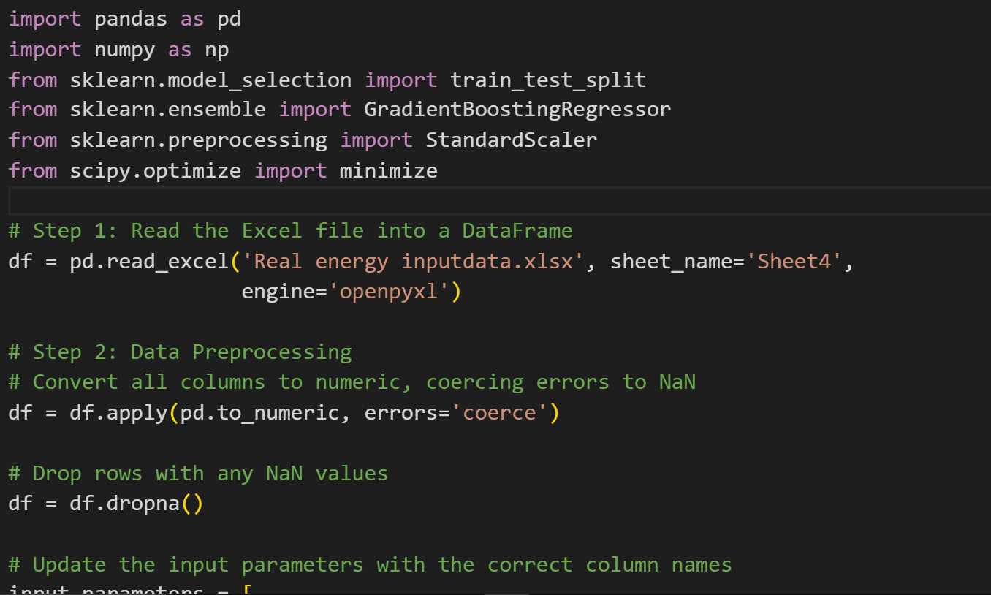
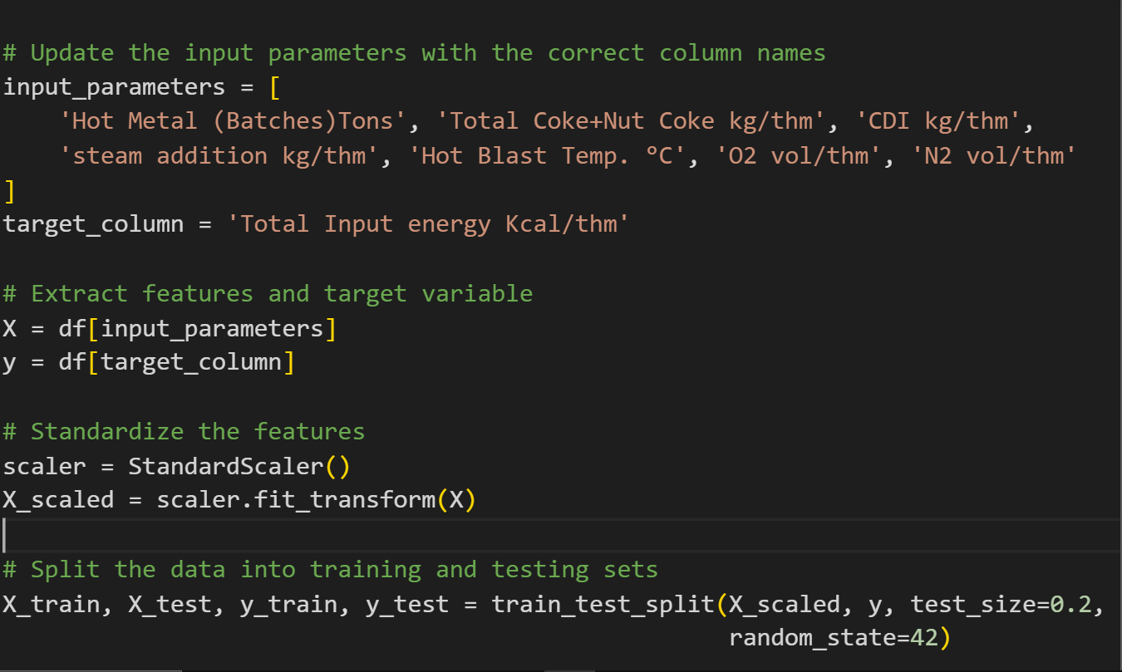
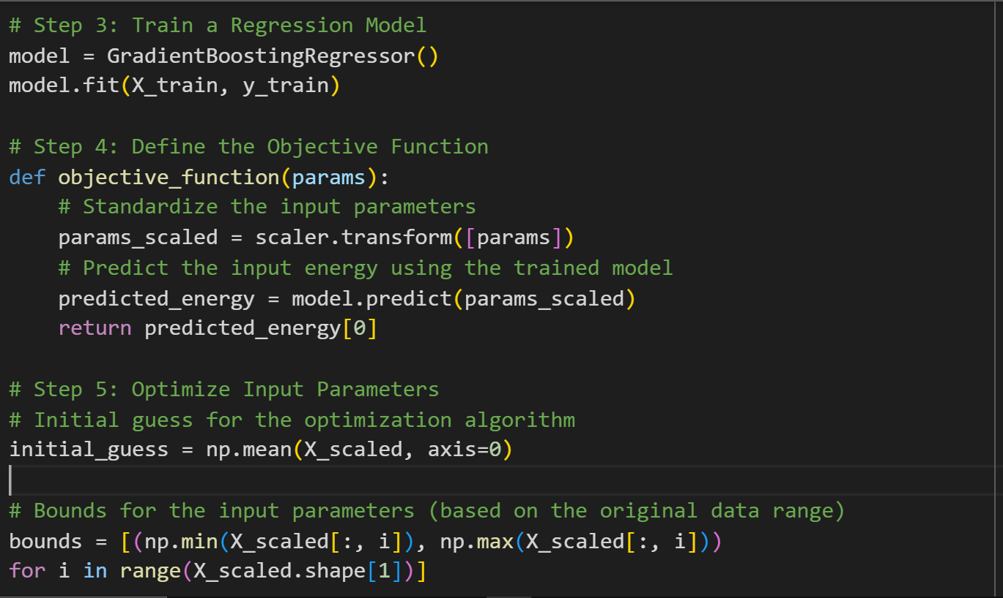
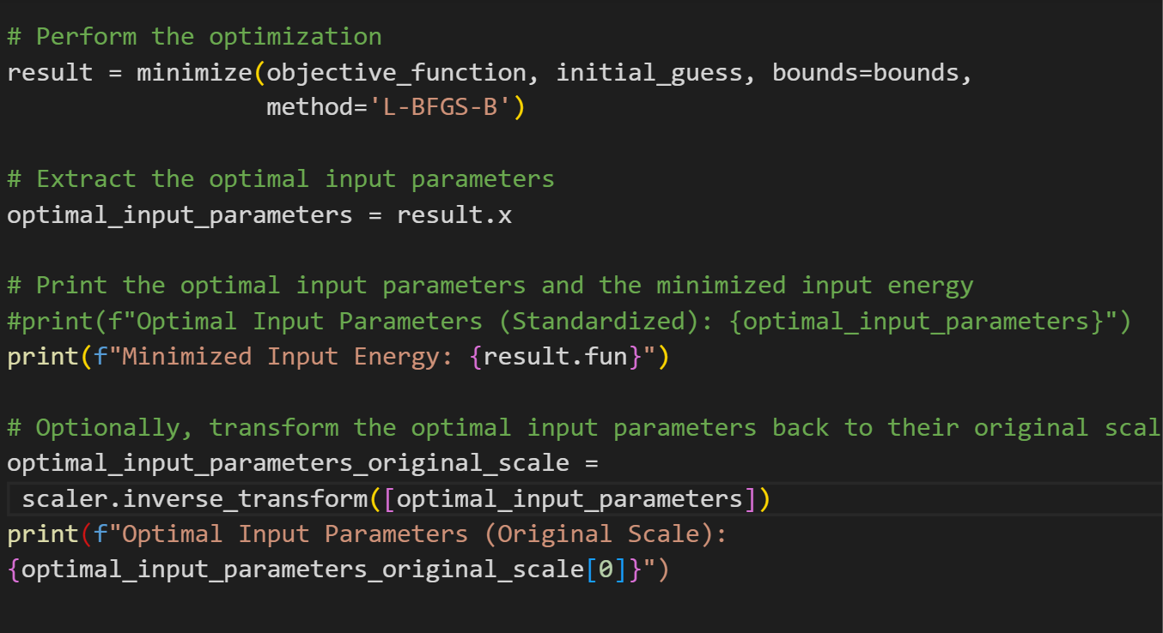
Code for Prediction Model(Model 1)
Results Of this Model 1
Minimized Input Energy: 3034787.99 Kcal/thm
Optimal Input Parameters (Original Scale):
Hot Metal (Batches)Tons: 9862.38
Total Coke: 325.90 kg/thm
CDI : 199.68 kg/thm
Steam addition : 14.72 kg/thm
Hot Blast Temp: 1146.65 °C
O₂ vol : 275.37 Nm3/thm
N₂ vol : 639.32 Nm3/thm

Slide 29



Method2: Linear Optimization model
Minimizing objective function - using Linear Optimisation
Preparation of Objective function for input energy
Obtaining Constraints on Output Parameters
Selecting KPI’s in Output Parameters
Obtaining Constraints on Input …..parameters using output constraints
Output

Slide 30
Input and Output Parameter Selection
Important KPIs for the Blast Furnace
Hot Metal Temperature
Hot Metal Carbon
Hot Metal Production
CO Emission per thm
Total Input Energy
ETA CO
The Input Parameters are the Parameters
in the Input Energy Equation
The volume of O₂ added from Hot Blast
The volume of N₂ added from Hot Blast
The amount of Coal added
The amount of Coke added
The Hot Blast Temperature

Slide 31
Constraints on the Output Parameter
The Constraints on the Output Parameter are based
on the Past Data trends as well as the Optimal or
Threshold value of the parameter
Hot Metal Temperature (1450 – 1510) °C
Hot Metal Carbon (40-45.5 Kg/thm)
Hot Metal Production (> 9600 tons/day)
Input Energy (<3.75 Gcal/thm)
CO emission in BF-gas (300 – 350 vol/thm)
Eta CO ( CO/(CO+CO2)) (0.5-0.55)

Slide 32
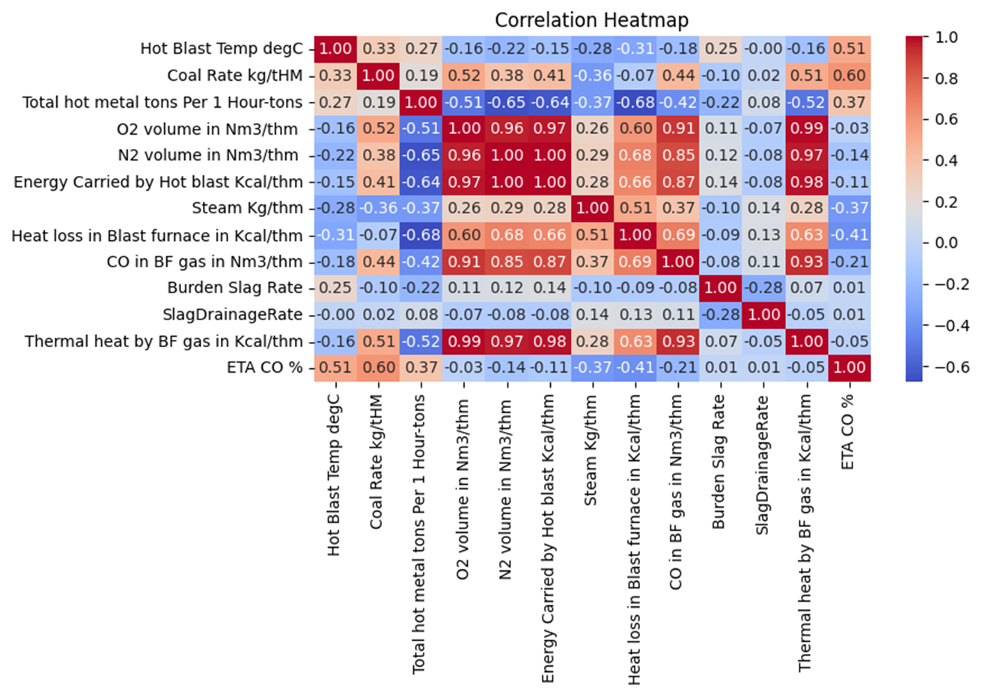
Correlation heat map between I/p and O/p parameters

Slide 33
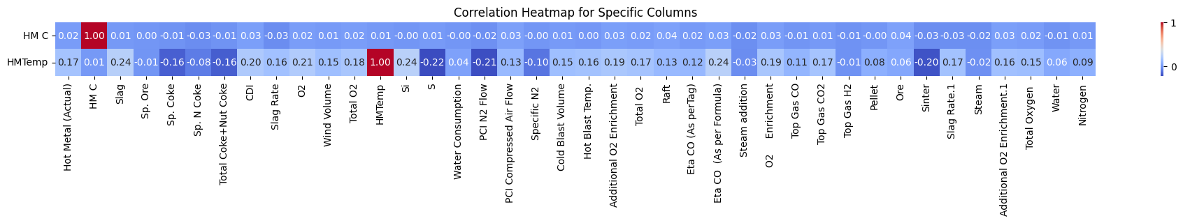
Correlation heat map for Hot metal carbon and Hot Metal Temperature with other parameters
From the above correlation matrix, it is concluded that Hot Metal Carbon and Hot Metal Temperature have no relation with any parameter, so we used the charts of past data to find the constraints on input parameters with respect to these output parameters

Slide 34
Methodology for finding the constraints
Output parameter constraints were selected based on the optimal value for the operation of blast furnace and analyzing furnace’s historical data
For the Input Parameters having no correlation with the Output Parameter, charts were plotted between input and output parameters(which are mainly KPI’s) and charts were visually analyzed for Input constraints. At last ranges on the output parameters were obtained by studying charts within constraints of output parameters.
Intersection of each Input parameters constraints which were obtained after inspecting it through all output parameters(which are KPI’s) were taken into consideration for using them in Optimization technique.
Coke<= -0.04375*HMP+771
Coke>=-0.025HP+558
CDI<=(0.025HMP-36)
CDI>=(0.035HMP-158)

Slide 35
Constraints on Coke
 | Hot Metal Production | CO Volume | ETA CO | Hot metal Carbon | Input Energy | Hot metal Temperature
Coke | 300-350 Coke<= -0.04375*HMP+771 coke>=-0.025HP+558 | 300-350 | 304-350 Coke<=2307*ETACO-829 | 305-350 | 300-335 | No Relation

Slide 36
Constraints on CDI
 | Hot Metal Production | CO Volume | ETA CO | Hot metal Carbon | Input Energy | Hot metal Temperature
CDI | 180-220 CDI<=(0.025HMP-36) CDI>=(0.035HMP-158) | 185-215 | 180-216 | 160-220 | 190-215 | No Relation

Slide 37
Constraints on Oxygen(O₂)
 | Hot Metal Production | CO Volume | ETA CO | Hot metal Carbon | Input Energy | Hot metal Temperature
O₂ | 265-290 O₂<=-0.026*HMP+542 | 263-287 | 264-290 O2<=785.2*ETACO-116.45 | 260-300 | 265-285 | 265-295

Slide 38
Constraints on Nitrogen (N₂)
 | Hot Metal Production | CO Volume | ETA CO | Hot metal Carbon | Input Energy | Hot metal Temperature
N₂ | 620-665 N₂<=-0.063*HMP+1267 N₂>=-0.0465*HMP+1089 | No Relation | 618-670 N2<=3506.9*ETACO-1120.3 | 620-690 | 615-665 | No Relation

Slide 39
Constraints on Hot blast temperature
 | Hot Metal Production | CO Volume | ETA CO | Hot metal Carbon | Input Energy | Hot metal Temperature
Hot Blast Temperature | No Relation | No Relation | No Relation | No Relation | No Relation | No Relation

Slide 40
*As there is no relation of Hot Blast Temperature with other parameters, a temperature of 1125 degree Celsius(most probable temperature ) is considered for optimal energy calculations
Final table of constraints for the input parameters
 | Hot Metal Production | CO Volume | ETA CO | Hot metal Carbon | Input Energy | Hot metal Temperature
Coke | 300-350 Coke<= -0.04375*HMP+771 coke>=-0.025HP+558 | 300-350 | 304-350 Coke<=2307*ETACO-829 | 305-350 | 300-335 | No Relation
CDI | 180-220 CDI<=(0.025HMP-36) CDI>=(0.035HMP-158) | 185-215 | 180-216 | 160-220 | 190-215 | No Relation
O₂ | 265-290 O₂<=-0.026*HMP+542 | 263-287 | 264-290 O2<=785.2*ETACO-116.45 | 260-300 | 265-285 | 265-295
N₂ | 620-665 N₂<=-0.063*HMP+1267 N₂>=-0.0465*HMP+1089 | No Relation | 618-670 N2<=3506.9*ETACO-1120.3 | 620-690 | 615-665 | No Relation
Hot Blast Temperature | No Relation | No Relation | No Relation | No Relation | No Relation | No Relation

Slide 41
Linear Programming
Using the input energy equation, we apply Linear Programming to the equation.
The primary goal of LP is to minimize the linear objective function, subject to a set of linear equality and inequality constraints.
Linear programming is a method to achieve the best outcome in a mathematical model whose requirements are represented by linear relationships
The components of the equation are the input energy components of which we have found the constraints for, now we apply Linear Programming in Python. Giving us the minimum value of the energy for particular set of values of the input parameters.

Slide 42
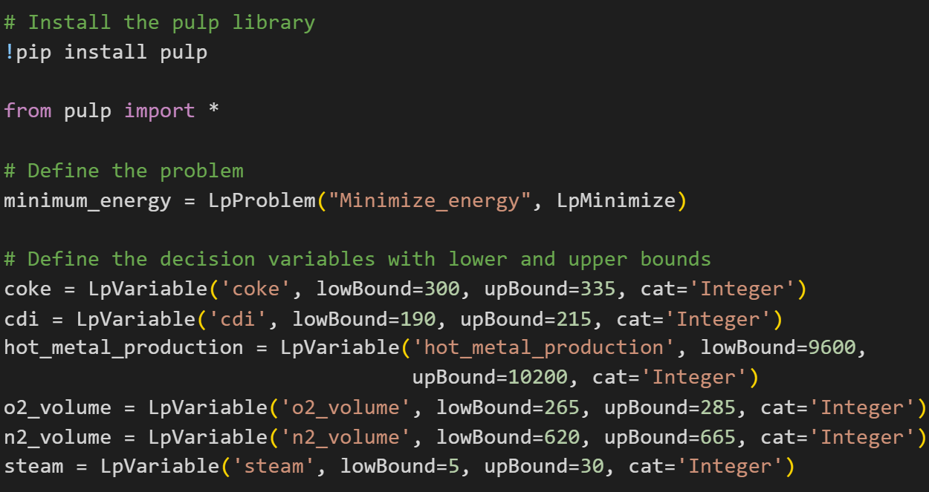
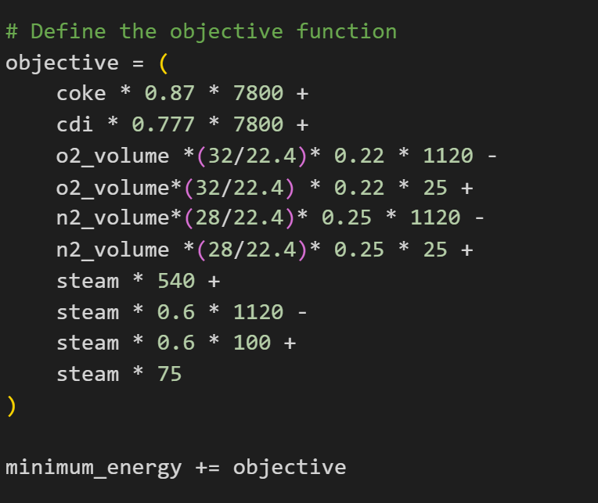
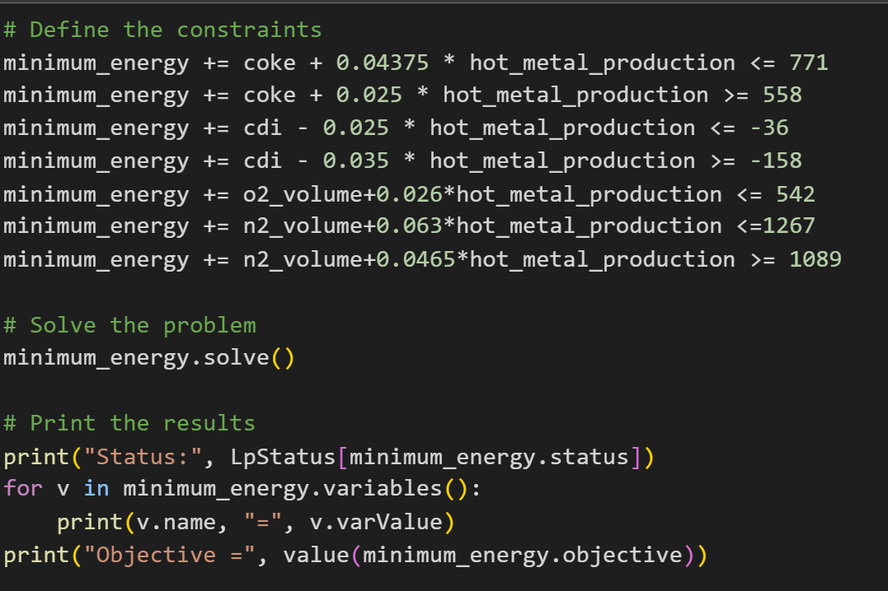
Code of Linear Optimization Technique(Model 2)
Results Of this Model 2
Minimized Input Energy: 3562549.2 Kcal/thm
Optimal Input Parameters (Original Scale):
Hot Metal (tons): 10000
Total Coke: 308.00 kg/thm
CDI kg/thm: 192.00
Steam addition kg/thm: 5.00
Hot Blast Temp. °C: 1125.00
O₂ weight(Kg)/thm: 378.00
N₂ weight(Kg)/thm: 768.00

Slide 43
*source: IndiaMart
Cost Analysis After Model Implementation
By Present Method
For financial year April’23 to March’24
There are 255 days where production is greater than 9600 tons/day.Only those days were considered for Cost calculation.
Total Hot metal production = 2516434 tons
Total amount of coke consumed = 82,00,96,640 kg
Total amount of coal consumed = 507749023 kg
Price of coke= Rs 12400/ton
Price of coal = Rs 4000/ton
Amount spent on coke =(820096640/1000)*12400
= Rs 10169198334
Amount spent on coal =(507749023/1000)*4000
= Rs 2030996092
Total amount spent =Rs. 12200194426
After Model Implementation
From present method for same amount of production i.e. 2516434 tons of hot metal
Amount spent on coke in Rupees after implementing the model =(2516434*308/1000*12400)
=Rs 9610765799
Amount spent on coke in Rupees after implementing the model =(2516434*192/1000*4000)
=Rs 1932621526
Total Amount Spent
=Rs 9610765799 + 1932621526
= 11543387325

Slide 44
Cost Analysis After Model Implementation
Amount spent on Coke and Coal using present method
1220 Cr.
Amount spent on Coke and Coal after implementing the model
1154.5 Cr
Amount Saved
65.5 Cr
Money spent on the Coke and Coal Can be decreased by 5.36% after implementation of model
Amount of Carbon used is decreased by 69629 tonnes/annum

Slide 45


